Slide 2

Introduction

Slide 3
WiFiMon: Introduction
Monitoring Wi-Fi network performance as experienced by end users
Combination of crowdsourced and hardware probe measurements
IEEE 802.1X networks (eduroam): Data from RADIUS and DHCP logs strengthen analysis options, e.g. per Access Point (AP)
Contribution:
Detection of Wi-Fi throughput degradation
Determination of underperforming areas within a Wi-Fi network
→ Admins may enhance performance, e.g. by installing more APs
WiFiMon vs other monitoring solutions:
Monitoring from the end user perspective (end user experience)
No requirements for end user intervention or installation of apps
Centralized view of Wi-Fi performance available to the Wi-Fi administrator

Slide 4
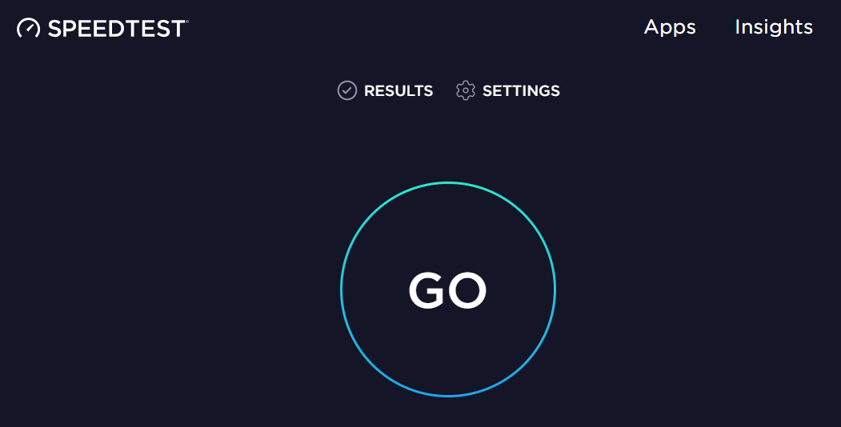
Example: WiFiMon vs Ookla Speedtest
WiFiMon | Ookla Speedtest
automatically by visiting a site | by pressing “GO”
the Wi-Fi administrator | the end users
Measurements are triggered:
Results are collected by:

Slide 5
Design Features & Operation

Slide 6
Design Features of WiFiMon
Combination of crowdsourced and hardware probe measurements
Correlation with RADIUS and DHCP logs respecting end user privacy
Independence of Wi-Fi technology and hardware vendor
Lightweight, active monitoring without significant impact on end user browsing experience

Slide 7
Components
WiFiMon Software Probes (WSP’s): Wi-Fi enabled end user devices, e.g. laptops and smartphones, that trigger crowdsourced measurements
WiFiMon Hardware Probes (WHP’s): Devices that trigger measurements from fixed locations within the Wi-Fi network to complement crowdsourced measurements (e.g. Raspberry Pi’s)
WiFiMon Test Server (WTS): Holds code and test data required for WSP/WHP performance measurements
WiFiMon Analysis Server (WAS): Central processing component of WiFiMon that collects, processes, correlates and stores measurements as well as provides visualizations to WiFiMon administrators

Slide 8
Reported Measurements
Performance Measurements: Estimations of download/upload throughput and HTTP Ping Round-Trip Time (both crowdsourced and hardware probes measurements)
Wireless network metrics: Bit rate, link quality, signal level and TX power from the WLAN NIC (hardware probes) – information about monitored and nearby ESSID’s
System metrics: CPU, memory and storage statistics (hardware probes)
Two-Way Active Measurement Protocol (TWAMP) measurements: Bandwidth, latency and packet loss estimations from TWAMP measurements among hardware probes and the WTS (hardware probes)

Slide 9
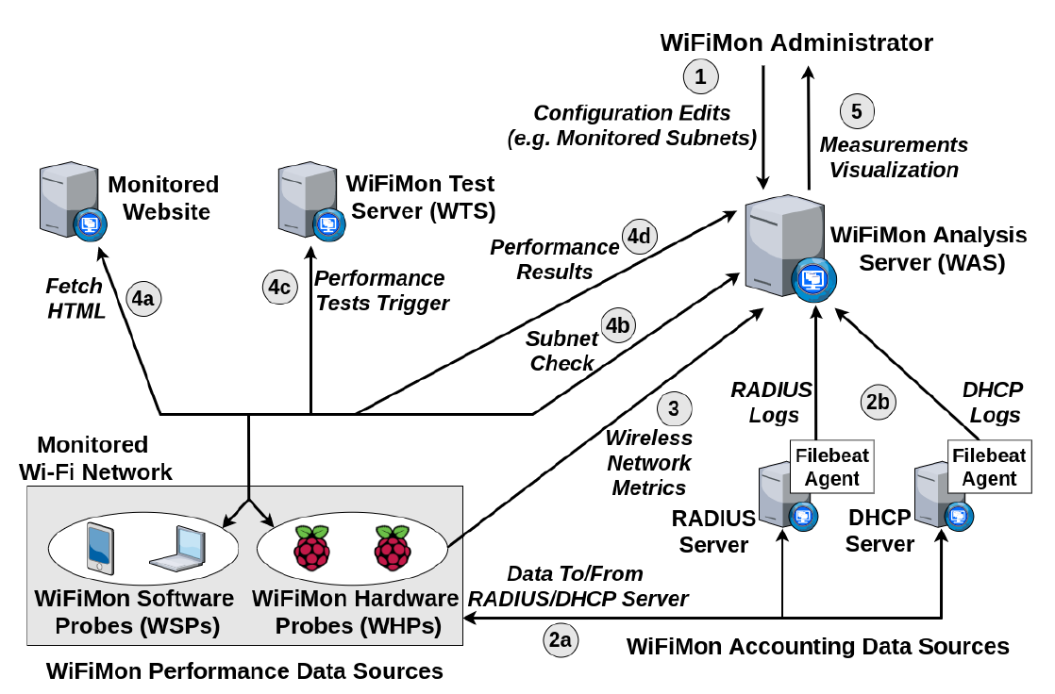
WiFiMon Operation
WiFiMon Components:
WiFiMon Software Probes (WSPs)
WiFiMon Hardware Probes (WHPs)
WiFiMon Test Server (WTS)
WiFiMon Analysis Server (WAS)

Slide 10
Installation

Slide 11
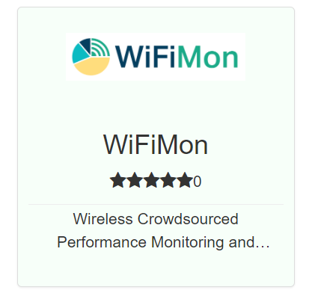
WiFiMon Installation
GÉANT Service since 2020!
Options:
Institutions install all components within their premises
- Ansible playbook for WAS automated installation
- Manual installation for WTS
- All data stay within the institution premises
- Support from WiFiMon team for all components
NMaaS Portfolio
NMaaS (more appropriate for testing/trying WiFiMon)
- Another GÉANT Service
- WiFiMon WAS instance deployed on NMaaS
- WTS installation still required by institutions
(should be close to the monitored network)
- Support from WiFiMon team for interfacing
WTS and Dockerized WAS on NMaaS
Manual WAS installation: Abandoned by WiFiMon

Slide 12
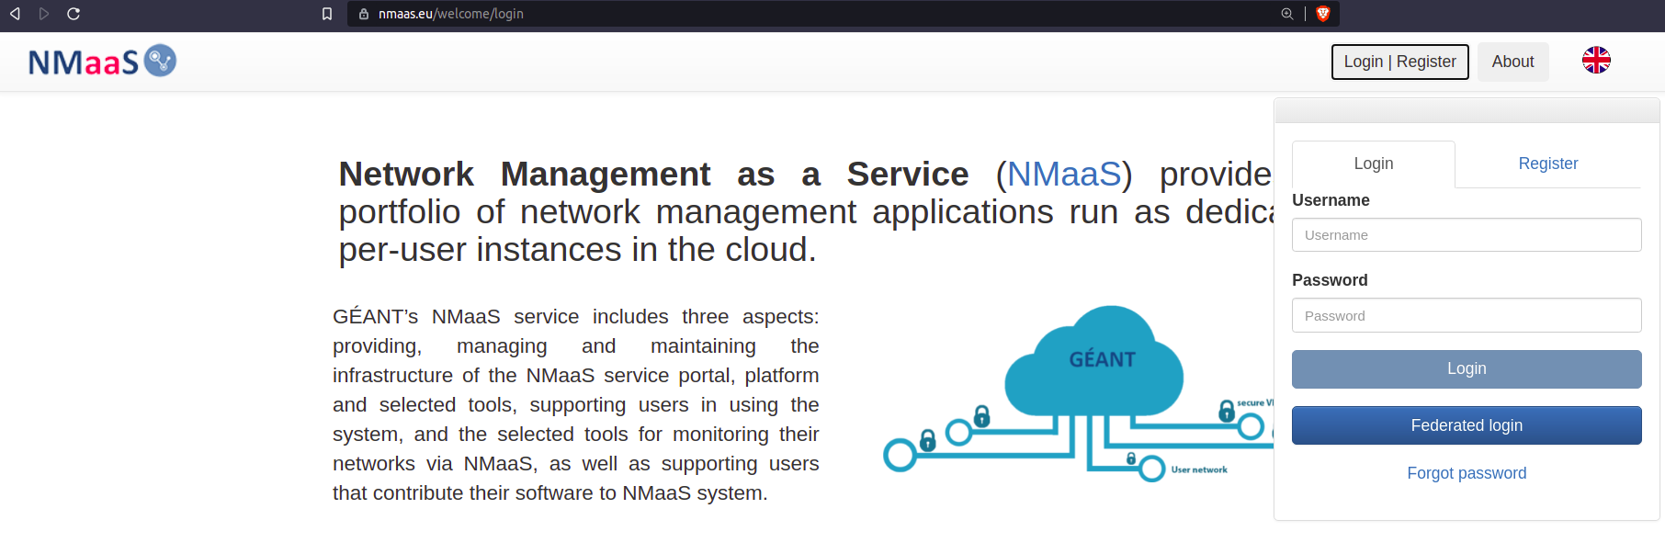
WAS NMaaS Installation (1)
Login to NMaaS platform via Federated Login

Slide 13
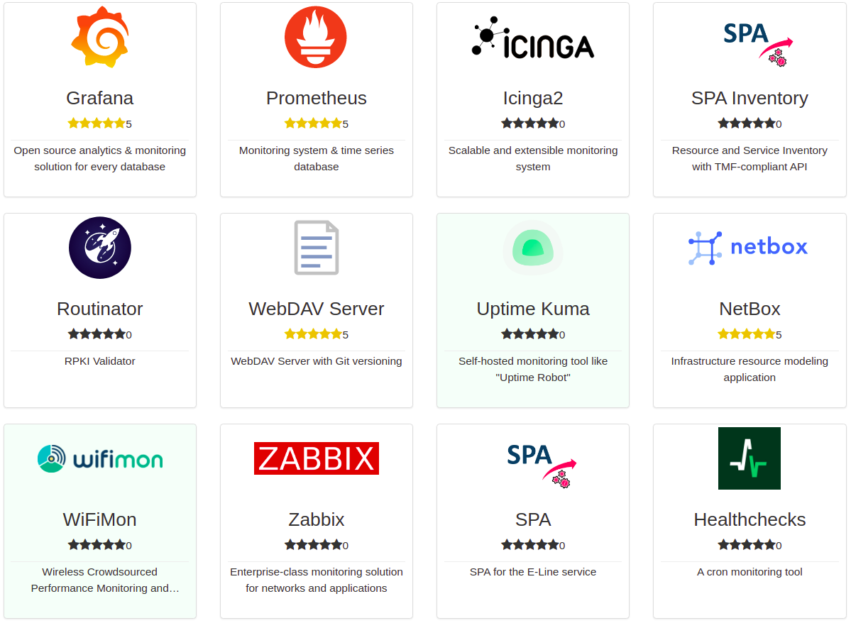
WAS NMaaS Installation (2)
Selection of WiFiMon from the NMaaS Portfolio of services

Slide 14
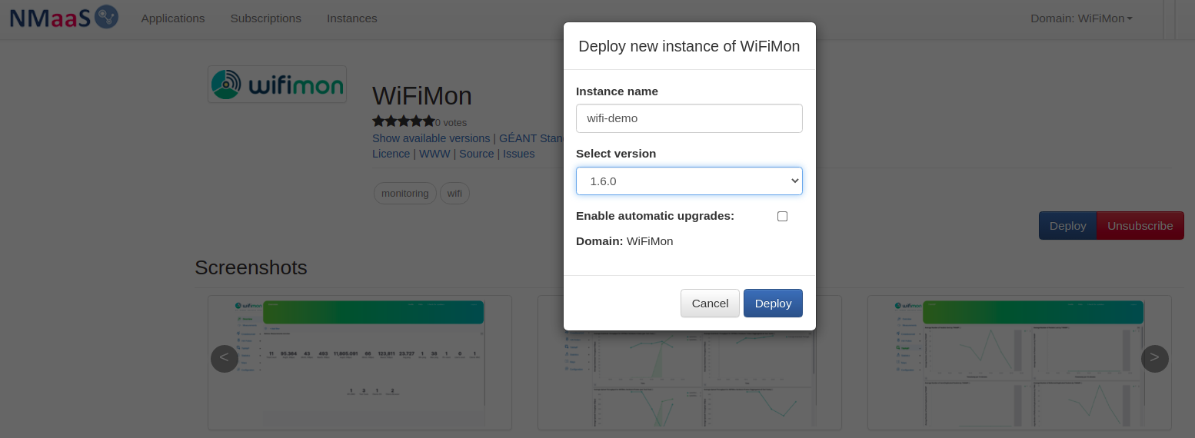
WAS NMaaS Installation (3)
Name the new instance
Select the version of the new instance
Deploy the instance

Slide 15
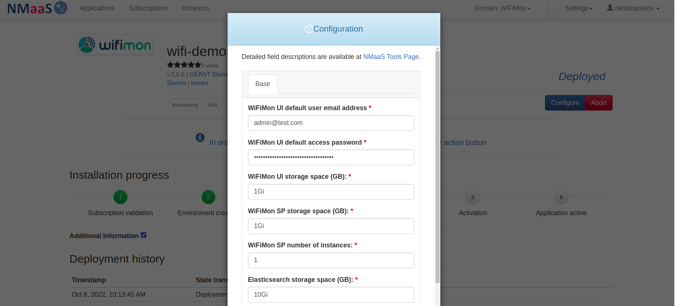
WAS NMaaS Installation (4)
Define the specifications of the new instance
Wait for the deployment of the instance

Slide 16
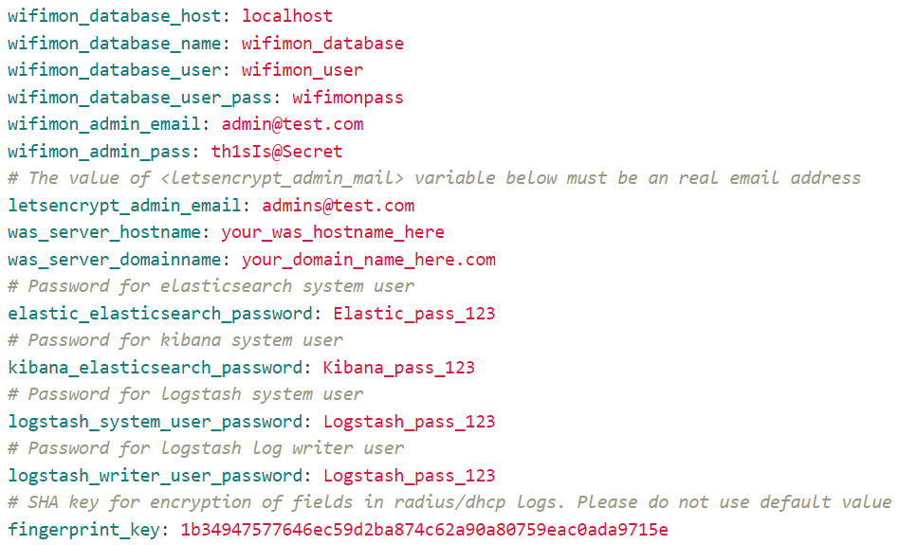
Ansible WAS Installation
Specs (minimum/recommended):
Operating Systems Tested:
4 CPU cores
8 GB / 16 GB RAM
10 GB / 50 GB Free Space
Debian 10
Debian 11
Ubuntu 18.04
Ubuntu 20.04
Other Requirements:
Ansible (and its requirements)
Root access
Appropriate DNS records
Filling details (e.g. passwords)
within a file (see figure)

Slide 17
WiFiMon User Interface

Slide 18
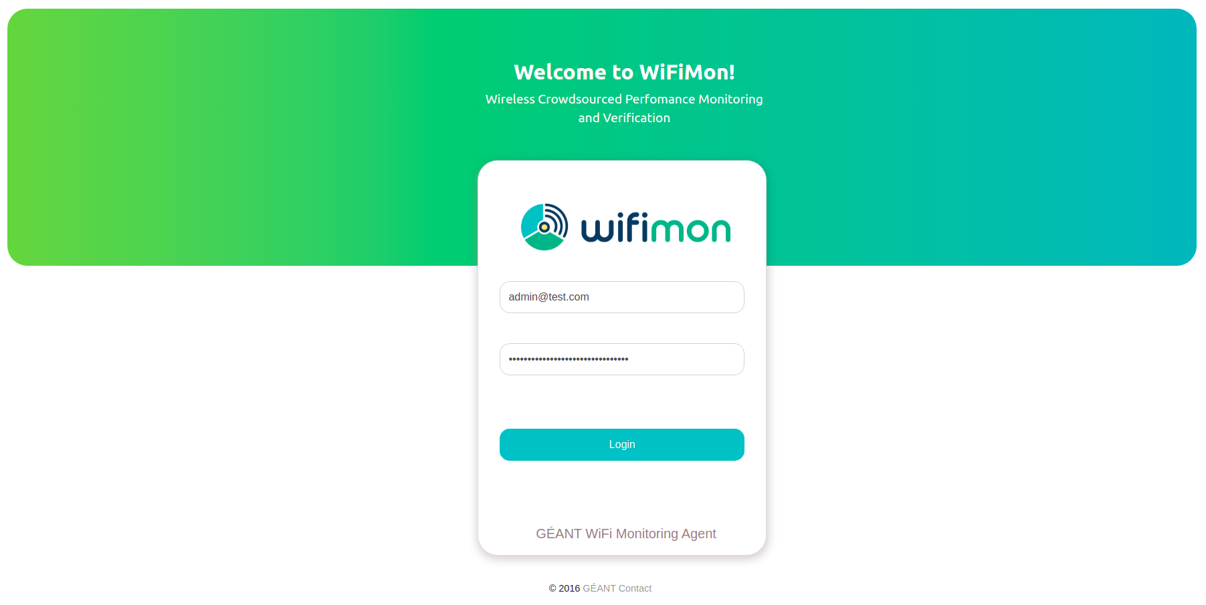
WiFiMon User Interface (1)
Login to WiFiMon UI using UI credentials

Slide 19
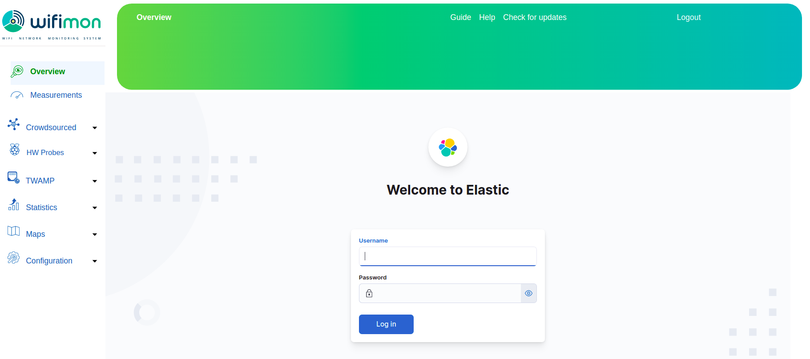
WiFiMon User Interface (2)
Measurement results are protected by X-Pack ELK plugin
X-Pack credentials are also required

Slide 20
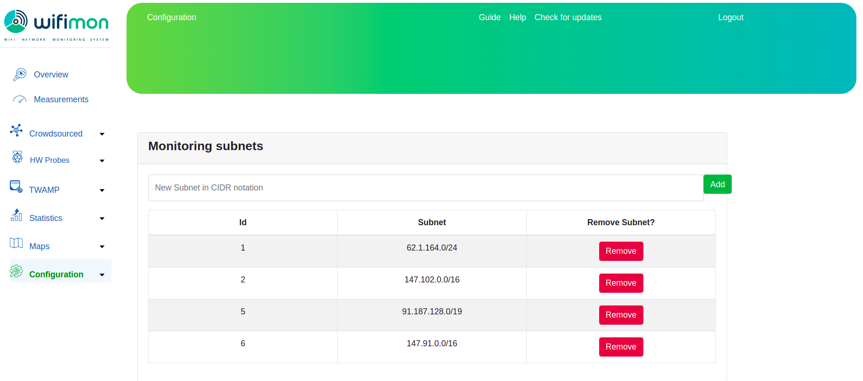
WiFiMon User Interface (3)
Define the Wi-Fi subnets to monitor
Excludes end users visiting WiFiMon websites from wired segments or other Wi-Fi networks

Slide 21
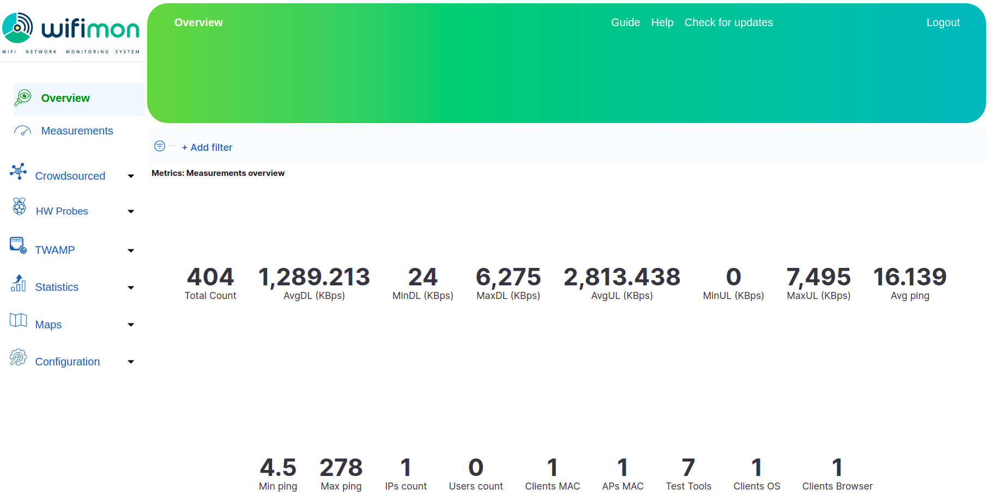
WiFiMon User Interface (4)
Overview tab: Overview of daily measurements

Slide 22
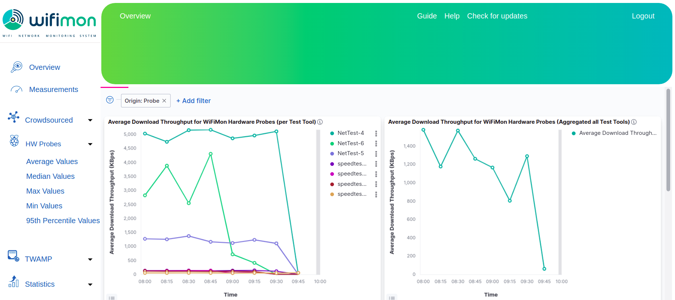
WiFiMon User Interface (5)
HW Probes tab: Download throughput estimations using multiple probes and the available test tools (NetTest, Akamai Boomerang, LibreSpeed Speedtest)

Slide 23
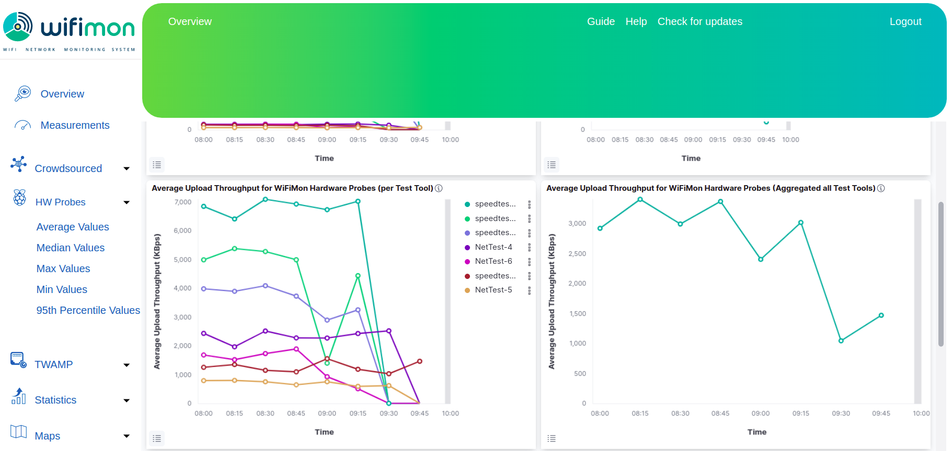
WiFiMon User Interface (6)
HW Probes tab: Upload throughput estimations using multiple probes

Slide 24
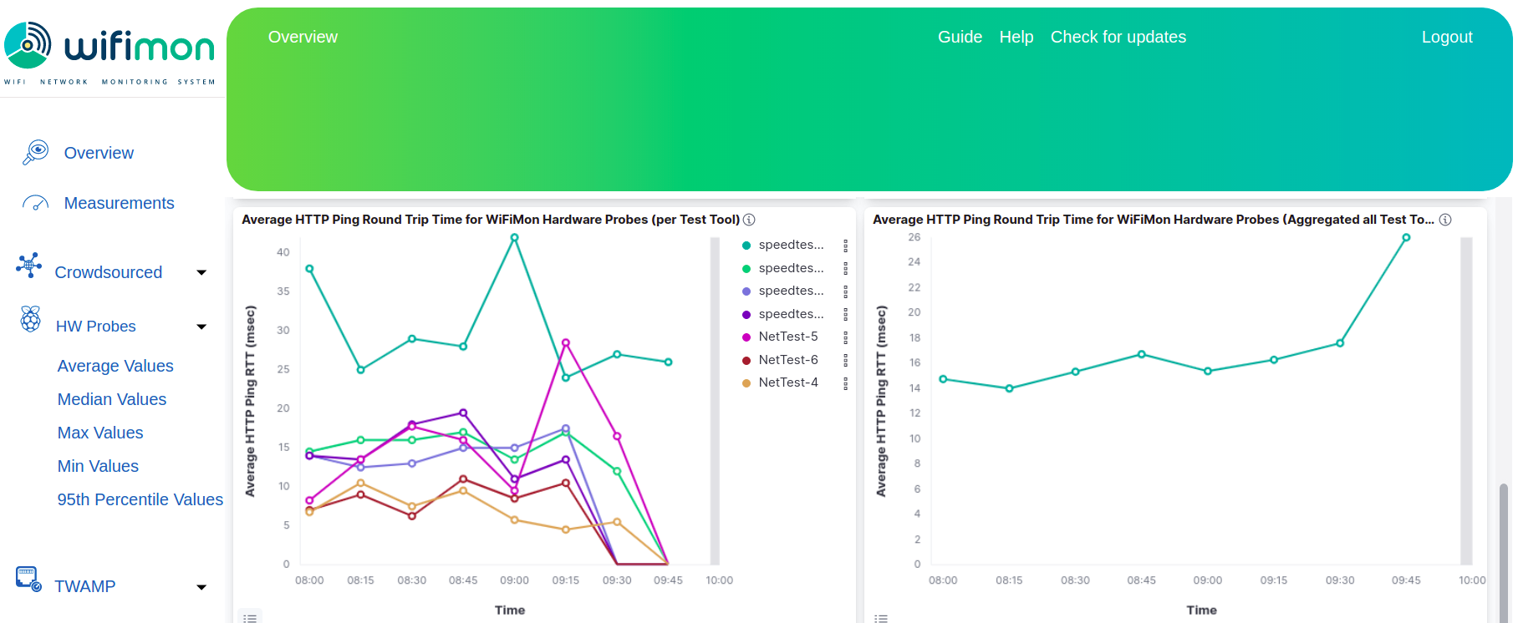
WiFiMon User Interface (7)
HW Probes tab: HTTP Ping Round Trip Time estimations using multiple probes

Slide 25
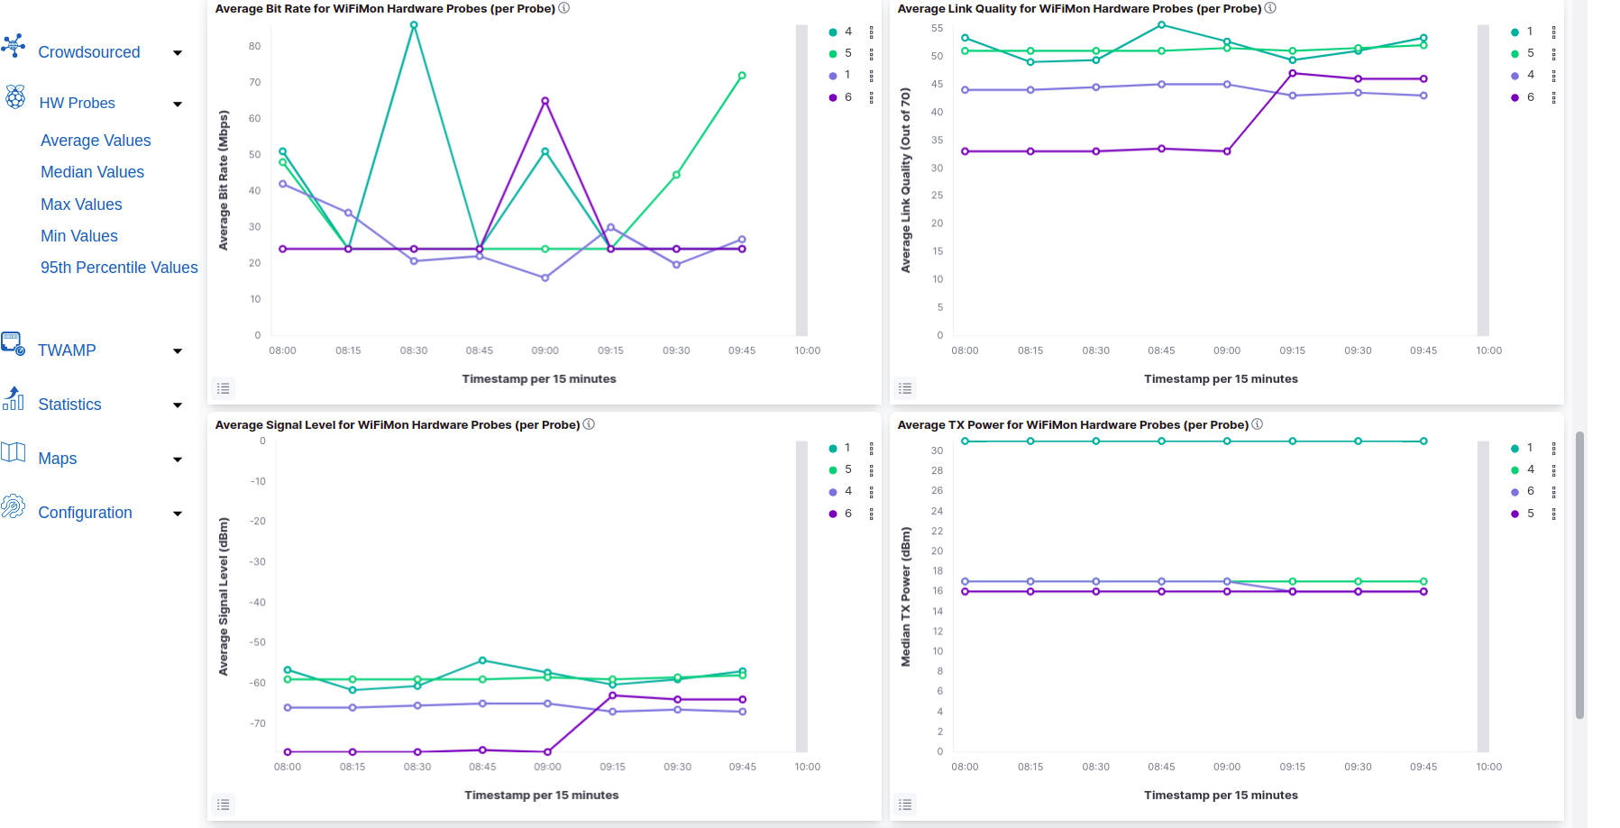
WiFiMon User Interface (8)
HW Probes tab: Metrics from probes (Bit rate, Link quality, Signal level, TX power)

Slide 26
WiFiMon User Interface (8)
Ability to report average/median/minimum/maximum/95th percentile values

Slide 27
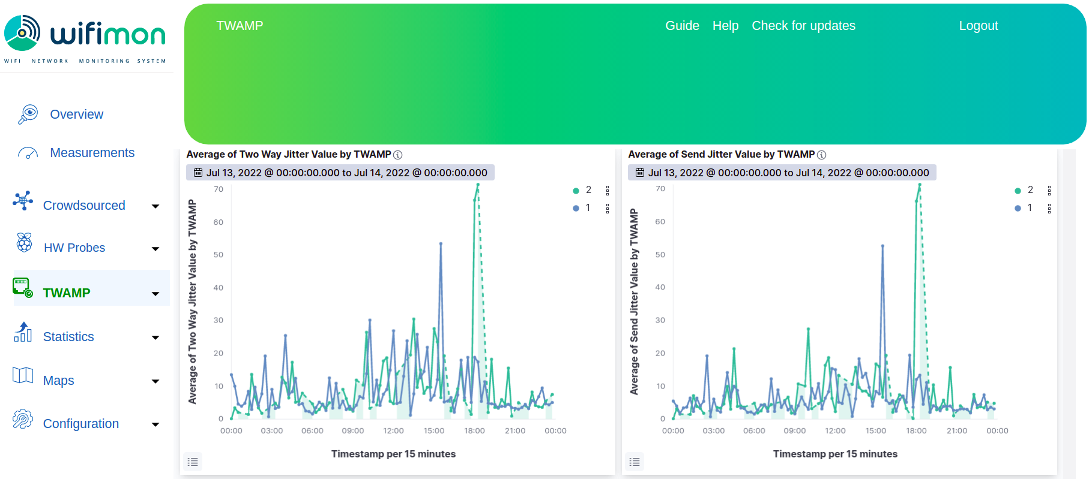
WiFiMon User Interface (9)
Support for TWAMP measurements among probes and WTS

Slide 28
Additional Features, Future Steps and Useful Links

Slide 29
Other Features of WiFiMon
Notification of WiFiMon version updates
- WiFiMon Users are informed of new versions from the UI
- Enables monitoring WiFiMon utilization (optional feature)
Log Exporter specifically designed for eduroam
- WHP data exported towards the JSON collector of eduroam (optional)
- May be used with any JSON collector
WTS location information
- Facilitates using multiple WTS instances
- Monitoring multiple sites with a single WAS
IPv6 Support
End User Number Approximation (currently tested)
Ping Statistics

Slide 30
Future Steps
Enrichment of monitoring tools
Automatic prediction of Wi-Fi performance drops (Time series analysis)
Automatic correlation between crowdsourced and probe measurements
Monitoring campus environments

Slide 31
Check out the WiFiMon video!
https://www.youtube.com/watch?v=9LuGlF6JSnA
… or the WiFiMon Infoshare
https://www.youtube.com/watch?v=VXQV2zWRKgo
… or previous presentations
https://wiki.geant.org/display/WIF/WiFiMon+Publications
… or the WiFiMon paper at IEEE/IFIP WONS 2021
http://dl.ifip.org/db/conf/wons/wons2021/1570695031.pdf

